Slide 1
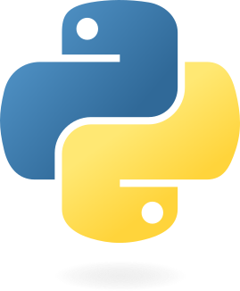
Python programming for the movement sciences
Jill Emmerzaal, Elodie Drew, Yunus Kaghembe, Bryce A Killen, Robbin Romijnders, Masoud Abedinifar, Julius Welzel, Clint Hansen, Philippe C. Dixon

Slide 2
Why learn Python

Slide 3
Versatile
Python is a versatile language with broad applications
Used in:
Web development
Data science
Machine learning
Automation
Integration
Easy to integrate with other technologies and platforms

Slide 4
Extensive libraries
Python has a lot of functionality within in the standard library, but its strength lies in the rich ecosystem of Packages that can be added and used.
Scientific libraries
NumPy
SciPy
Pandas
Matplotlib
Machine learning
TensorFlow
Keras
Scikit-learn
Biomechanics
Pyomeca
Kinetics toolkit
Gait and Movement Analysis Package

Slide 5
Costs and Accessibility
Python is free and open-source, making it accessible to anyone without the need for expensive licenses
Plus a large and active community
Extensive recourses, tutorial and forums

Slide 6
Ease of Learning and Use
Python's syntax is clean and easy to read
Readability enhances productivity and reduces learning curve.
Python allows for rapid prototyping and iteration
Speeds up development of new tools.

Slide 7
Cross-Platform Compatibility
Python code runs on various operating systems such as Windows, macOS, and Linux without modification

Slide 8
Data Handling and Analysis
Python libraries offer powerful tools for data manipulation and analysis, which are highly useful for handling complex datasets
The visualization toolboxes Matplotlib, Seaborn and Plotly provide advance plotting capabilities for scientific papers.

Slide 9
Automation and Scripting
Python is well-suited for automating repetitive tasks
Automating taskscan save time and reduce errors in data processing and analysis workflows
Python scripts can be easily integrated into pipelines for data collection, processing, analysis, and visualization

Slide 10
Career and Collaboration Opportunities
Python is in high demand in many industries, including healthcare, research, and tech, which can enhance career prospects
Python’s popularity across various disciplines facilitates collaboration with people from other fields

Slide 11
Interoperability with MATLAB
MATLAB provides support for calling Python functions directly, allowing you to leverage Python’s capabilities without completely transitioning away from MATLAB.

